Slide 1

Gratitude++ Journal Application
Developers
Joel Scott and Benjamin Seifried

Slide 2

Agenda
Technology
Design
Known Bugs
Future work

Slide 3
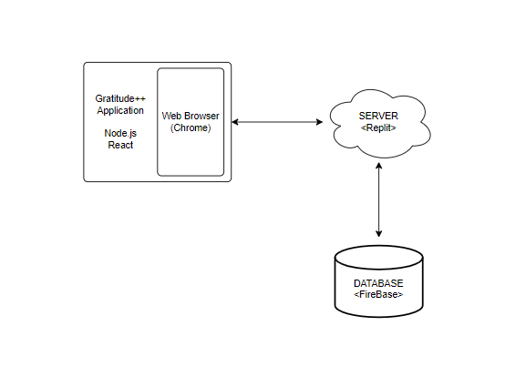
Technology
ReactJS
NodeJS
CSS Stylesheets
Firebase Realtime-Database
Replit.co
GitHub

Slide 4
Developer Experiences
Benjamin
Tasked Primarily with front-end
ReactJS
NodeJS
Replit.co
GitHub
Joel
Tasked Primarily with Back-End
NodeJS
Firebase
Replit.co
GitHub

Slide 5
Design

Slide 6
Featured Elements
Authentication
Home Page
Navigation
Journal Entry Creation
Settings

Slide 7

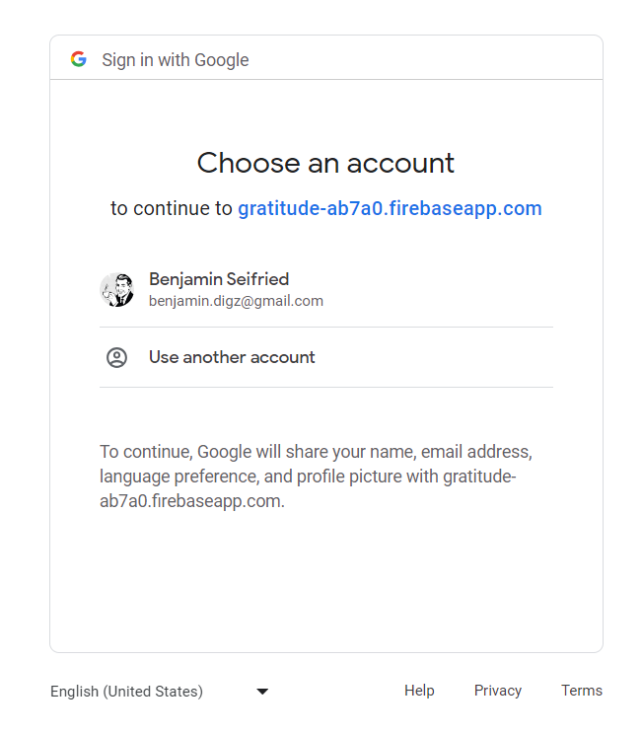
Authentication

Slide 8
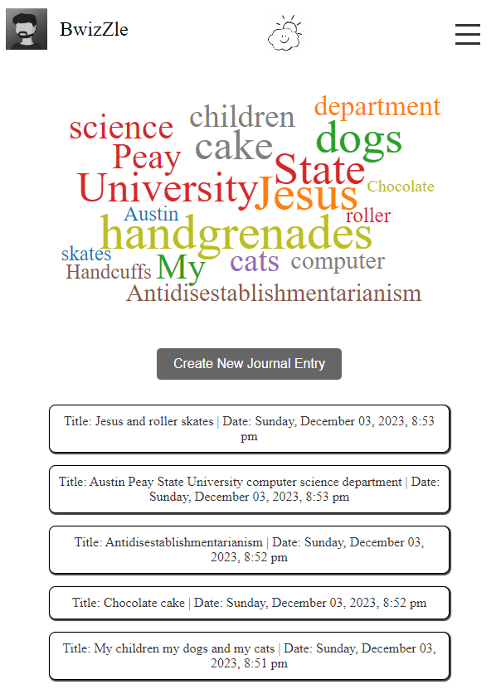
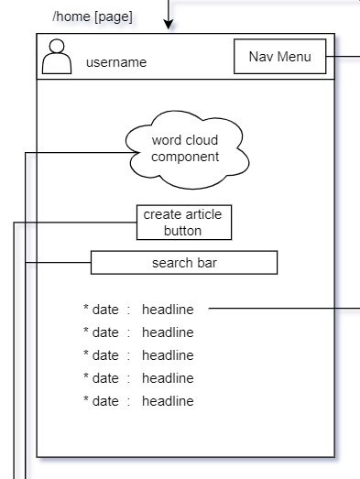
Home Page

Slide 9
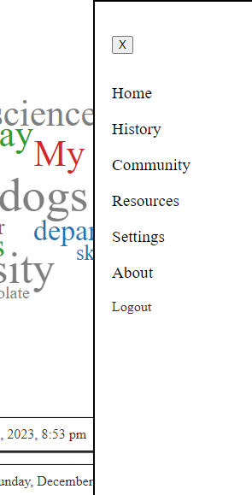
Navigation

Slide 10
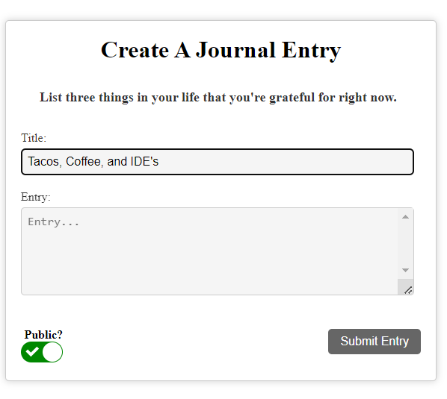
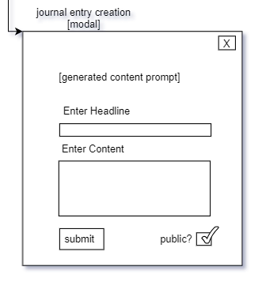
Journal Entry Creation

Slide 11
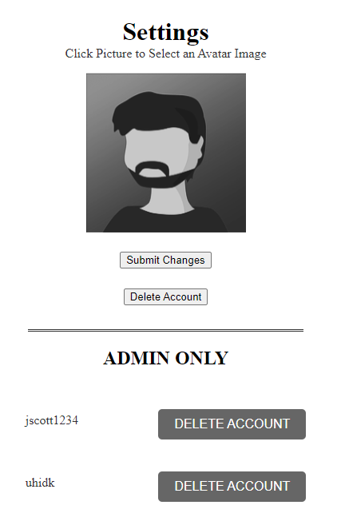
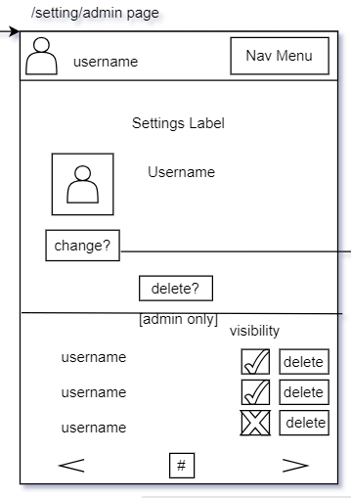
Settings

Slide 12
Known Bugs
Word cloud Rendering
Google Authentication Inconsistencies
Authorized Page Access
Mobile to Laptop Styling

Slide 13
Future Work
Expanded Word Cloud Filtering
Theme Selection Component
Cloud Mask Element
Audio/Video Input
User Data
Full Testing and Debugging

Slide 14
Conclusion of Project
The Project Prototype and the development process were deemed a success by the team.
Future Development iterations would certainly improve on a solid foundation created and presented here.

Slide 15

Demonstration
https://gratitude-app.joelscott1.repl.co/

Slide 16
Thank YOu

